Slide 1
HTTP

Slide 2










Web Application Architecture
Web Server
Application Server
Web Browser
Storage System
HTTP
Internet
LAN

Slide 3
http://www.example.com:80/index.html
Protocol http
URL
Uniform Resource Locator
Server www.example.com
Port 80
File index.html
HTTP HyperText Transfer Protocol
Simple request-response protocol layered on TCP/IP
HTML HyperText Markup Language

Slide 4
request
Get /index.html HTTP/1.1
Host www.example.com
Accept text/html, */*
Header
Accept-Language en-us
Accept-Charset ISO-8859-1,utf-8
User-agent Mozilla/5.0
Connection keep-alive
Body
(Optional)

Slide 5
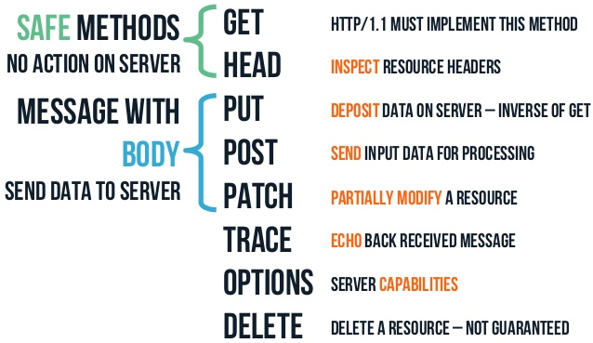
Method

Slide 6
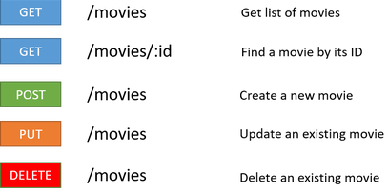
REST
REST Representational State Transfer
CRUD Create, Read, Update, Delete
RESTful

Slide 7




HTTP Request-Response
Web Browser
Web Server
http://www.naver.com
HTTP
Internet

Slide 8
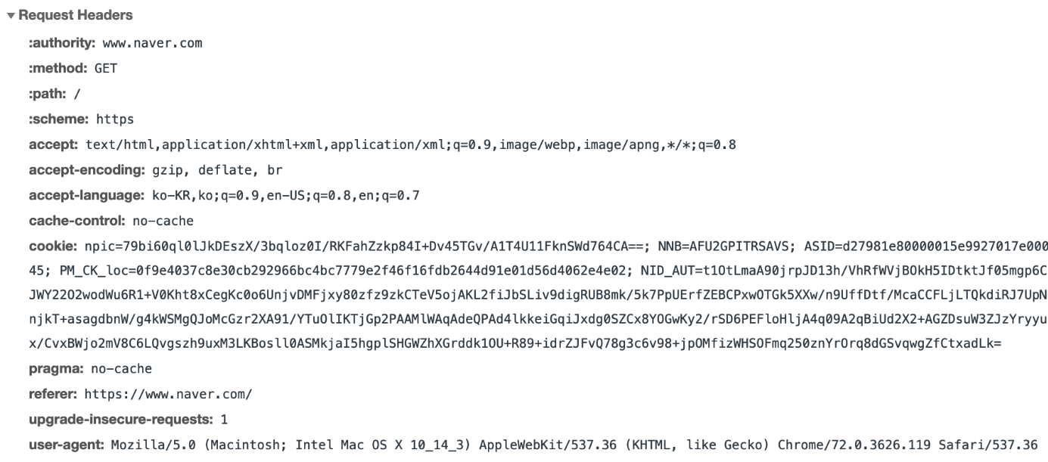
http://www.naver.com
HTTP Request
TCP-IP / Internet
Protocol https
Server www.naver.com
Port 80

Slide 9
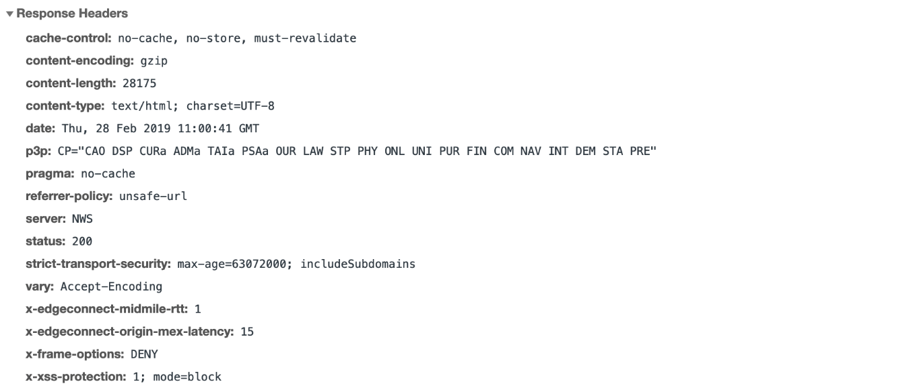
http://www.naver.com
HTTP Response
TCP-IP / Internet

Slide 10
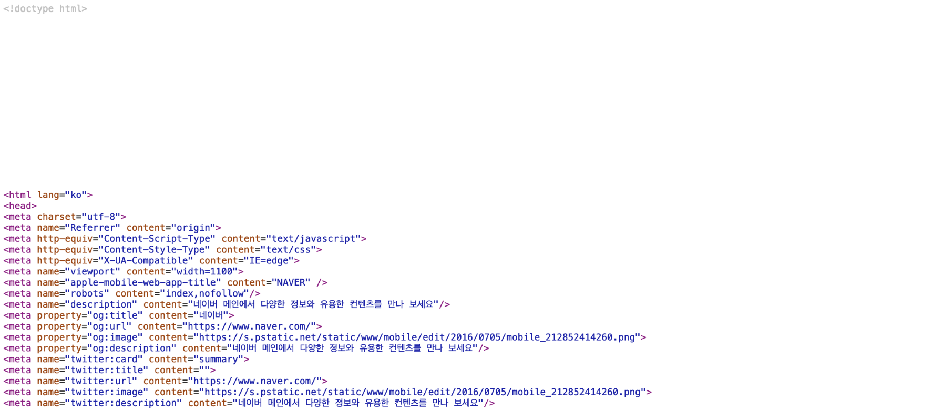
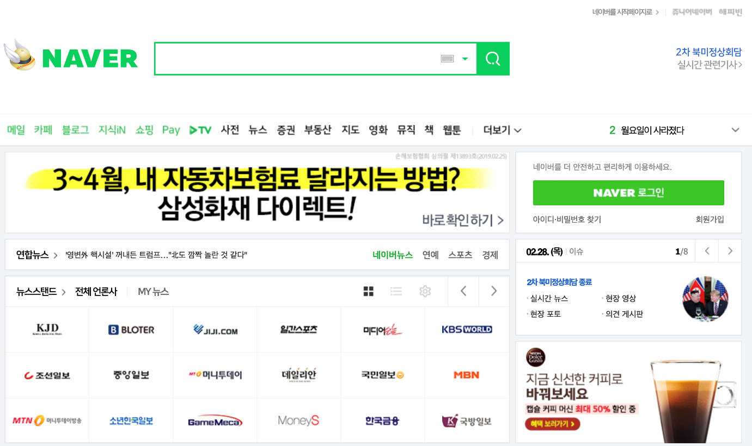
Browser Rendering
Rendering
HTTP Response-Body

Slide 11
How to prepare Dataset
Crawling / Scraping

Slide 12
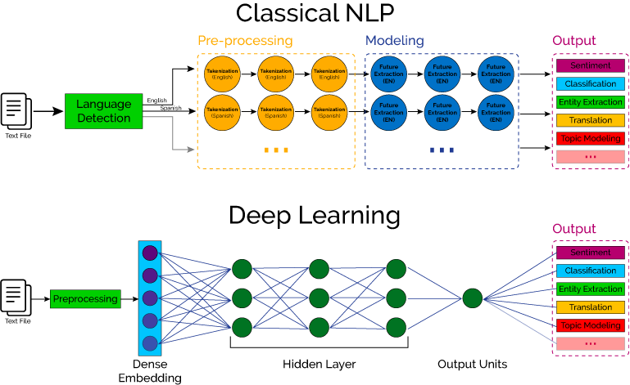

Slide 13
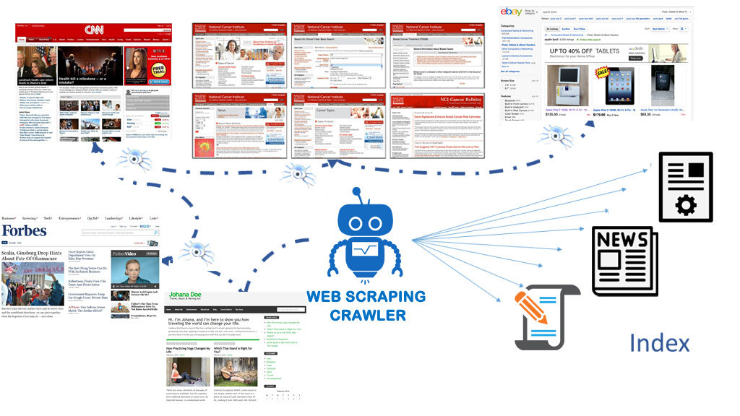
Crawler, Spider, Agent, Bot, …

Slide 14
Legal Issues

Slide 15
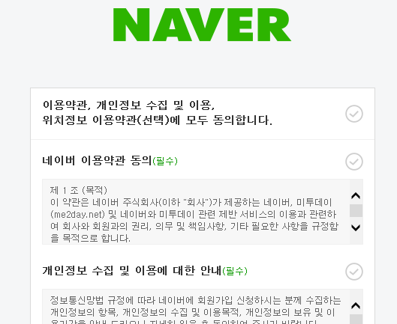
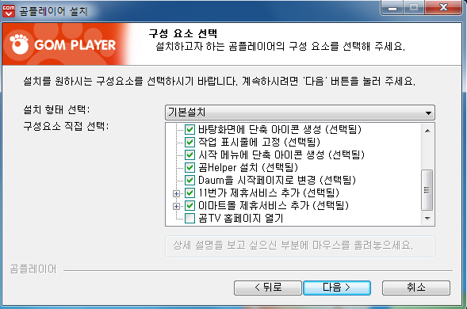
Opt-in vs Opt-out
Opt-in 정보수집을 명시적으로 동의할 때에만 정보수집 가능; Whitelist
Opt-out 정보수집을 명시적으로 거부할 때에만 정보수집 중단; Blacklist
Opt-in 개인정보
Opt-out 서비스 동의

Slide 16
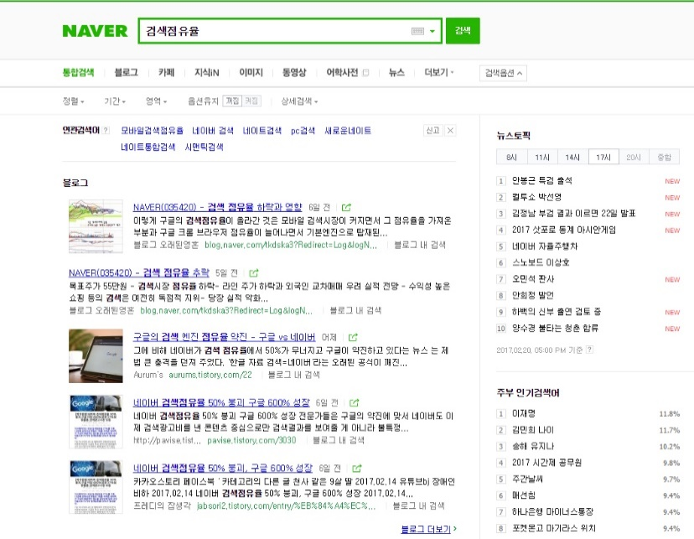
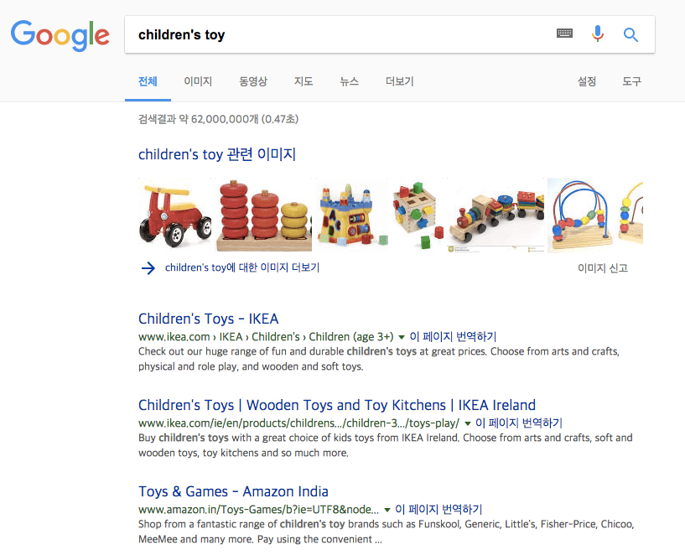
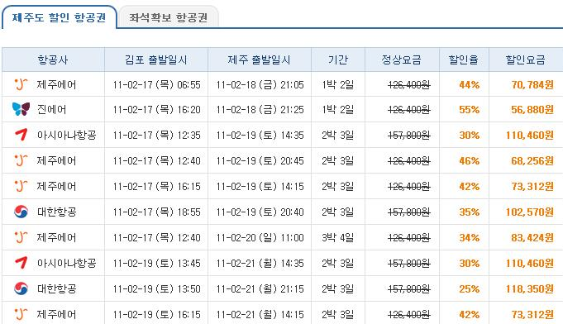
합법이다
Opt-out 검색엔진(bot, spider, crawler, etc.), 가격비교 등
위법? 사이트 운영자의 의사에 반하지 않으면 합법

Slide 17
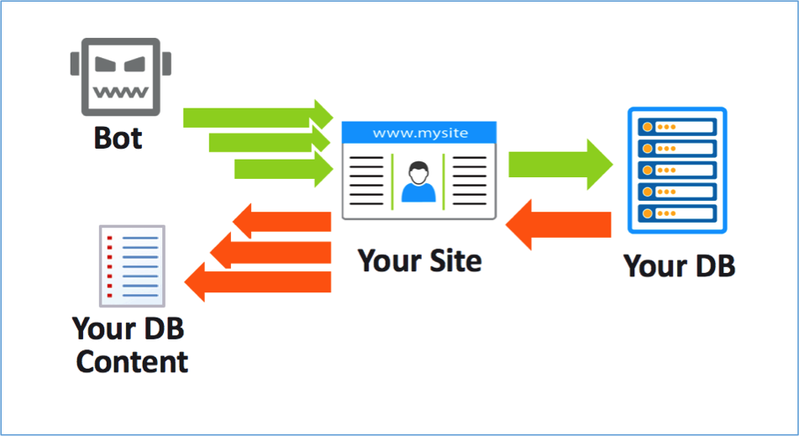
불법이다
트래픽
개인정보
이용방침
지적재산권

Slide 18




사례

Slide 19

이용방침
이용방침 준수 사이트 정보 이용에 대한 방침(안내, 약관 등) 미리 확인

Slide 20
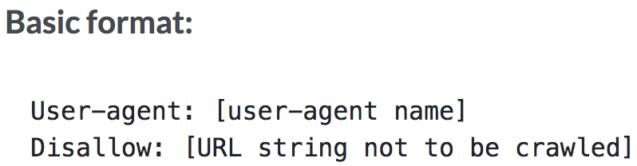
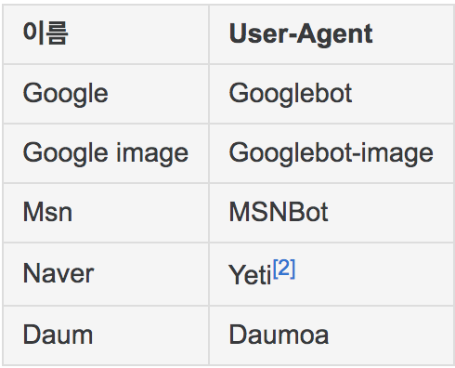
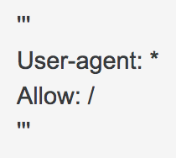
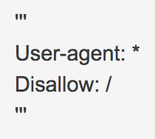
robots.txt
robots.txt Crawler와 같은 (Ro)bot 접근을 제어하기 위한 규약
대상 봇, 수집 여부, 수집 범위 등 기술

Slide 21
어떤 사이트를 수집 하느냐 보다는, 어떤 데이터를 수집 하느냐가 문제!
1. Robots.txt 접근 제약 규칙 준수
2. Crawl delay 사이트에 최대한 부담 지양
3. Term of use 사이트 이용방침(약관) 준수
4. Public content 지적재산권 침해 여부 주의
5. Authentication-based sites 민감한 정보 수집 주의

Slide 22
Tips
builtwith Detect the technology used by a website
!pip install builtwith
from builtwith import builtwith
builtwith('http://wordpress.com')
builtwith('http://webscraping.com')
builtwith('http://microsoft.com')
builtwith('http://jquery.com')
builtwith('http://joomla.com')
whois Retrieving WHOIS information of domains
!pip install python-whois
from whois import whois
whois('http://wordpress.com')
whois('http://webscraping.com')
whois('http://microsoft.com')
whois('http://jquery.com')
whois('http://joomla.com')

Slide 23
urllib

Slide 24
URL handling module
urllib.request Opening and reading URLs
urllib.error Containing the exceptions raised by urllib.request
urllib
urllib.parse Parsing URLs
urllib.robotparser Parsing robots.txt files
urllib.response Used internally by the urllib.request module
from urllib import request

Slide 25
robotparser
RobotFileParser This module provides a single class, RobotFileParser,
answers questions about whether or not a particular user agent
can fetch a URL on the Web site that published the robots.txt file
from urllib import robotparser
robot = robotparser.RobotFileParser()
robot.set_url('https://www.google.com/robots.txt')
robot.read()
robot.can_fetch('AgentName', 'https://www.google.com')

Slide 26
request
urlopen Open the URL url, which can be either a string or a Request object
Returns a http.client.HTTPResponse object slightly modified
geturl return the URL of the resource retrieved
info return the meta-information of the page
getcode return the HTTP status code of the response
from urllib import request
resp = request.urlopen('https://www.google.com')
resp.geturl()
resp.reason
resp.getcode()
print(resp.info())
resp.getheaders()

Slide 27
URL parameters
parameters Made of a key and a value separated by = and joined by &
First parameter always comes after ? in a URL
https://www.google.com/search?newwindow=1&ei=wv94XLabGZLk_Aa9vomIAw&q=%ED%8C%8C%EC%9D%B4%EC%8D%AC&oq=%ED%8C%8C%EC%9D%B4%EC%8D%AC&gs_l=psy-ab.12...0.0..1777...0.0..0.0.0.......0......gws-wiz.xIvFJMss_h8
{newwindow : 1}
{ei : wv94XLabGZLk_Aa9vomIAw}
{q : %ED%8C%8C%EC%9D%B4%EC%8D%AC}
{oq : %ED%8C%8C%EC%9D%B4%EC%8D%AC}
{gs_l : psy-ab.12...0.0..1777...0.0..0.0.0.......0......gws-wiz.xIvFJMss_h8}
ASCII₁₆
URL Encoding
Hexadecimal
Percent-Encoding

Slide 28
read
read Reads and returns the response body, or up to the next amt bytes
from urllib import request
resp = request.urlopen('https://www.google.com/search?q=%ED%8C%8C%EC%9D%B4%EC%8D%AC')
resp.read()
[Out] b'<!doctype html> …
resp.read().decode('utf-8')
[Out] '<!doctype html> …
HTTPError: HTTP Error 403: Forbidden

Slide 29
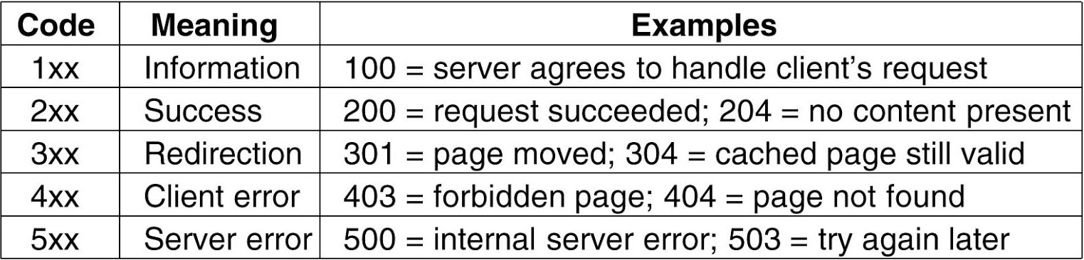
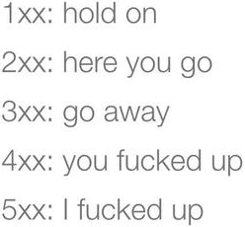
HTTP Status Codes

Slide 30
HTTPError
HTTPError Handling exotic HTTP errors, such as requests for authentication
code numeric value corresponds to an HTTP status code
reason the reason for this error
headers HTTP response headers for the HTTP request
from urllib import error
req = request.Request('https://www.google.com/search?q=%ED%8C%8C%EC%9D%B4%EC%8D%AC')
try:
resp = request.urlopen(req)
except error.HTTPError as e:
print(e.code)
print(e.reason)
print(e.headers)
X-XSS-Protection prevent some level of XSS (cross-site-scripting) attacks

Slide 31
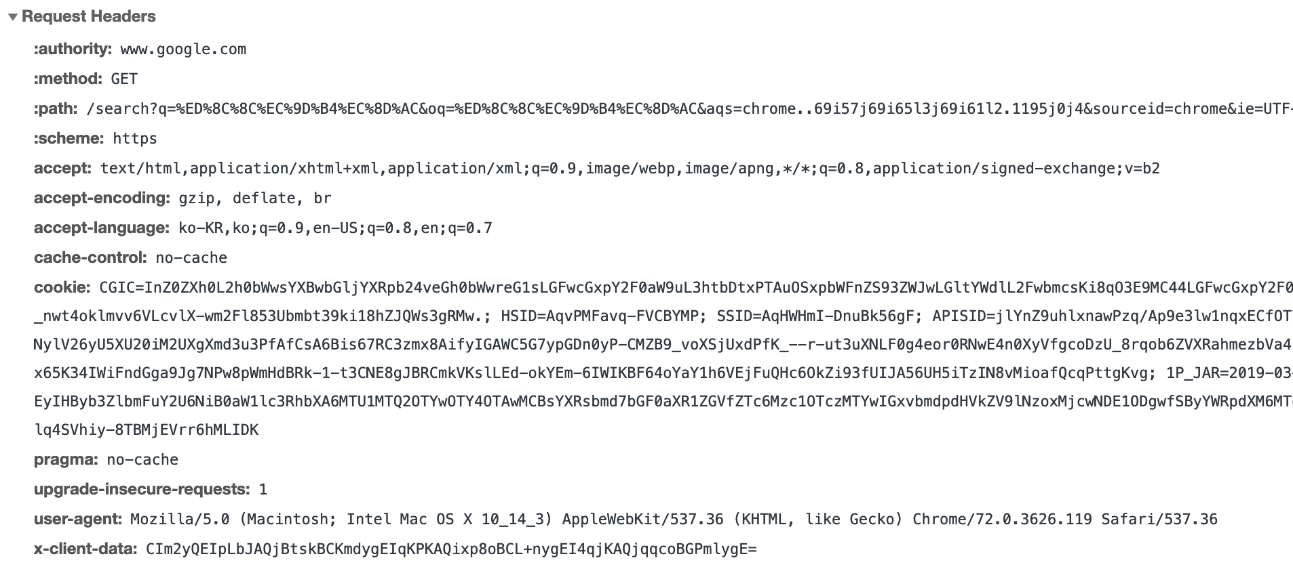
User-agent
robots.txt
User-agent: *
Disallow: /search

Slide 32
urlparse
urlparse Break URL strings up in components
(addressing scheme, network location, path etc.)
Combine the components back into a URL string
Convert a relative URL to an absolute URL given a base URL
from urllib import parse
parse.urlparse('https://www.google.com/search?q=%ED%8C%8C%EC%9D%B4%EC%8D%AC')
parse.urljoin('https://www.google.com/search?q=%ED%8C%8C%EC%9D%B4%EC%8D%AC','/search/about')
parse.urlencode({'q':'파이썬'})
parse.quote_plus('파이썬')
parse.unquote_plus('%ED%8C%8C%EC%9D%B4%EC%8D%AC')

Slide 33
requests

Slide 34
URL handling module
requests.get
requests.post
requests.put
requests
requests.delete
Making a request with Requests is very simple
requests.head
requests.options
requests.response
import requests

Slide 35
exercises
http://httpbin.org

